Slide 1
Tom Tom
Sequence Diagrams
Michael Warne
Lucas Van Egeraat
Saipirun Spanprom
Shan Jiang
Marcus Näslund
Philp Malm

Slide 2
System Sequence Diagram
The picture that shows for one particular scenario of a use case
An important part of analyzing system behavior.

Slide 3
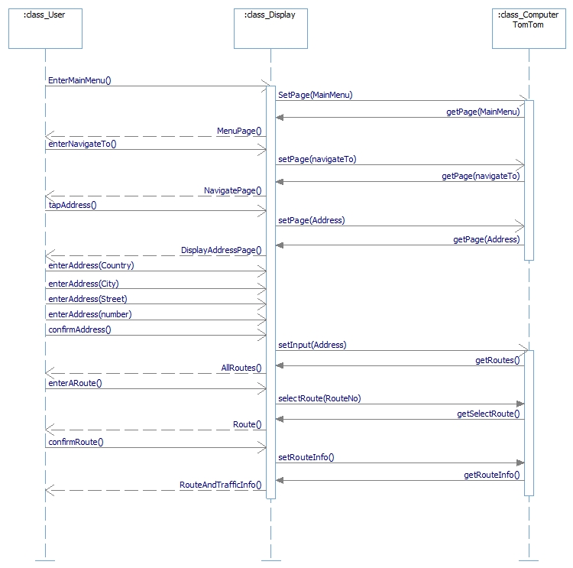
SSD for basic flow

Slide 4
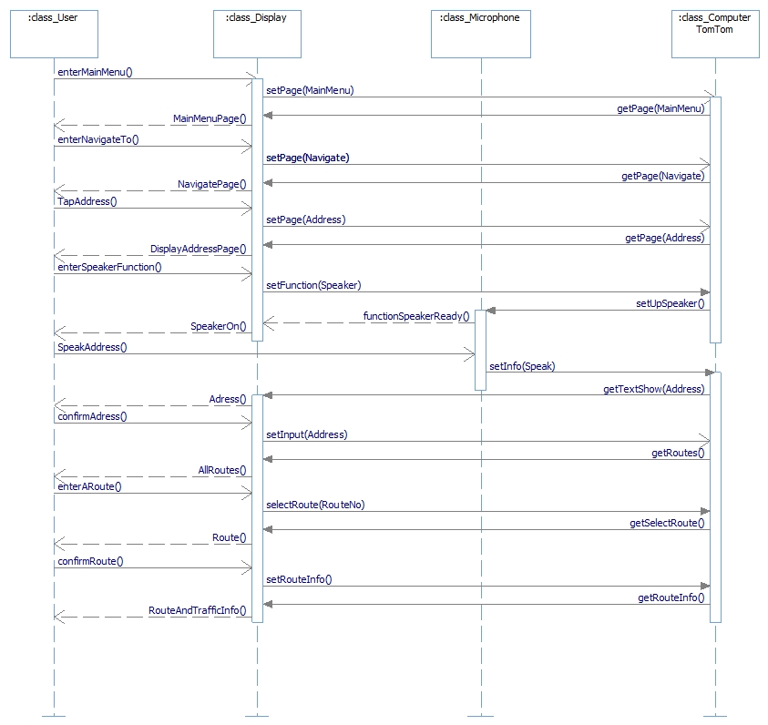
SSD for an alternative flow

Slide 5
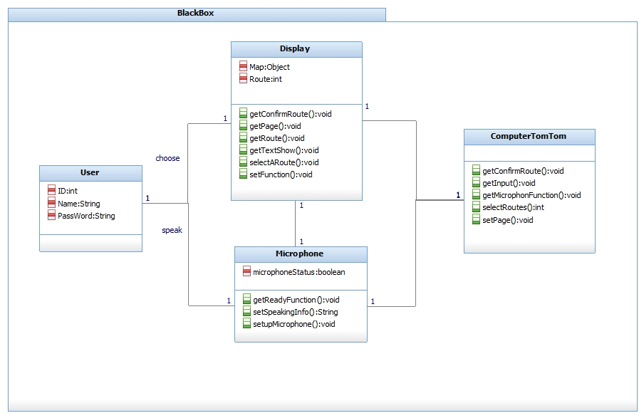
Black Box Diagram

Slide 6
Use Case Realization
Describes how a particular use case is realized within the Design Model
Used to remind us of the connection between the requirements expressed as use cased and the object design that satisfies the requirements

Slide 7
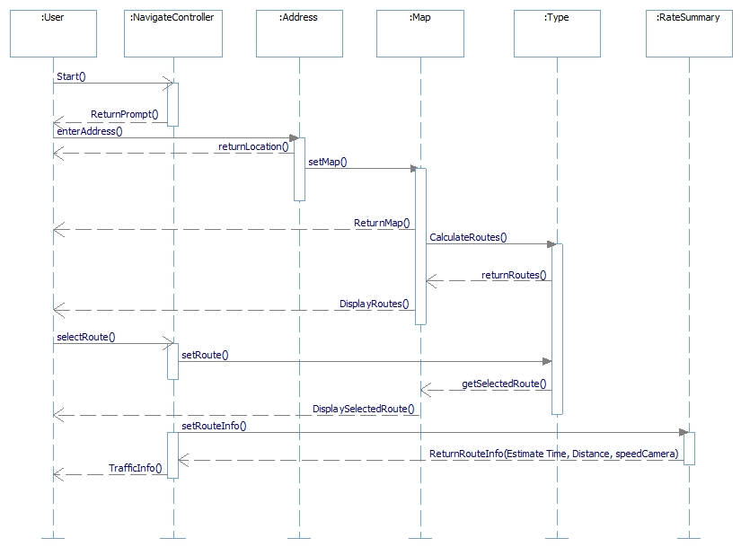
UCR for basic flow

Slide 8
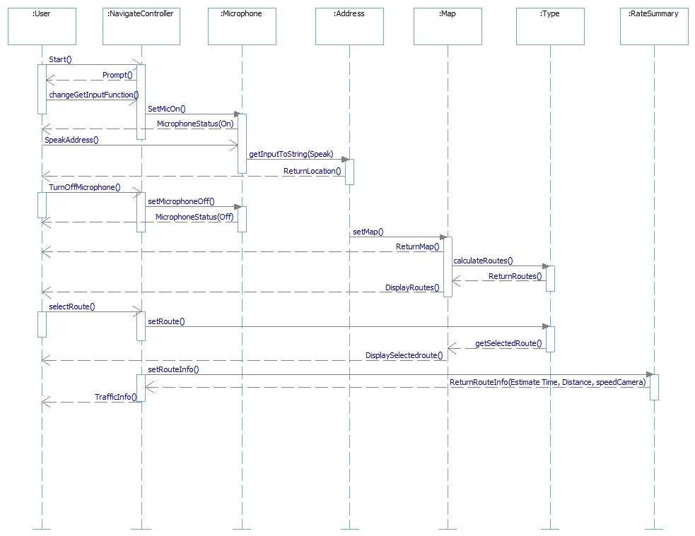
UCR for alternative flow

Slide 9
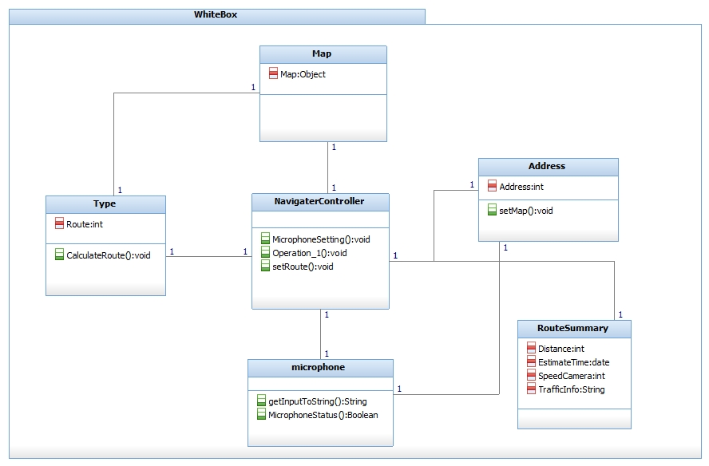
White Box

